Slide 1
Unit -1
Fundamental concepts of operating systems
Presentation By
Prof. A. R. Jadhav

Slide 2
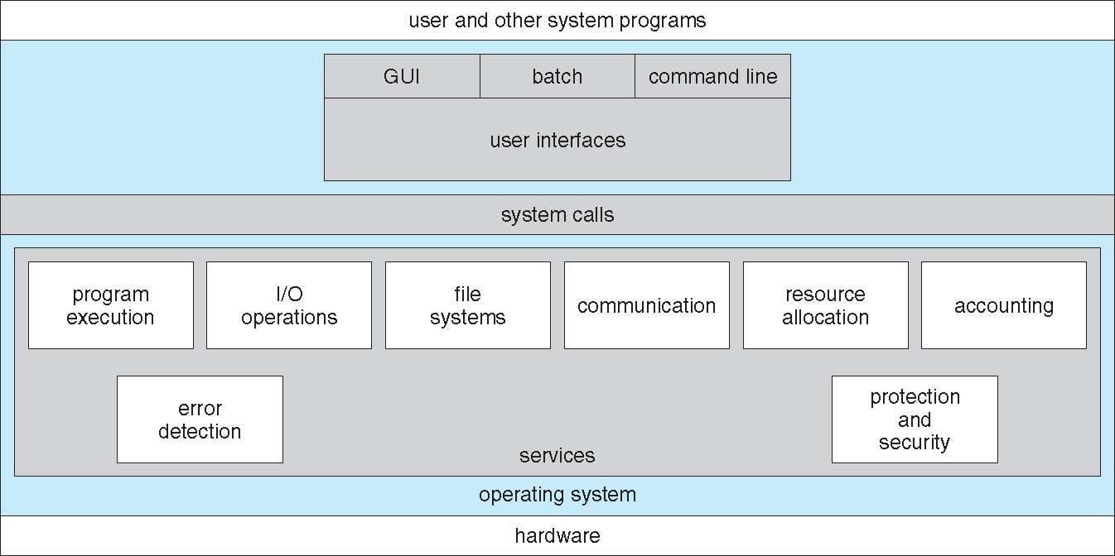
Operating System Services

Slide 3
Operating System Services
Operating systems provide an environment for execution of programs and services to programs and users.
User interface - Almost all operating systems have a user interface (UI) that varies between Command-Line (CLI), Graphics User Interface (GUI), Batch.
Program execution - The system must be able to load a program into memory and to run that program, end execution, either normally or abnormally (indicating error)

Slide 4
…services contd.
I/O operations - A running program may require I/O, which may involve a file or an I/O device
File-system manipulation - The file system is of particular interest. Programs need to read and write files and directories, create and delete them, search them, list file Information, permission management.
Communications – Processes may exchange information, on the same computer or between computers over a network
Communications may be via shared memory or through message passing (packets moved by the OS)

Slide 5
…Services contd…
Error detection – OS needs to be constantly aware of possible errors
May occur in the CPU and memory hardware, in I/O devices, in user program
For each type of error, OS should take the appropriate action to ensure correct and consistent computing
Debugging facilities can greatly enhance the user’s and programmer’s abilities to efficiently use the system

Slide 6
…Services contd..
Resource allocation - When multiple users or multiple jobs running concurrently, resources must be allocated to each of them
Many types of resources - CPU cycles, main memory, file storage, I/O devices.
Accounting - To keep track of which users use how much and what kinds of computer resources
Protection and security - The owners of information stored in a multiuser or networked computer system may want to control use of that information,

Slide 7
..Services contd..
concurrent processes should not interfere with each other.
Protection involves ensuring that all access to system resources is controlled
Security of the system from outsiders requires user authentication, extends to defending external I/O devices from invalid access attempts.

Slide 8
Types of Operating System
Batch Operating System
Time-sharing Operating System
Network Operating System
Distributed Operating System
Real-Time Operating System

Slide 9
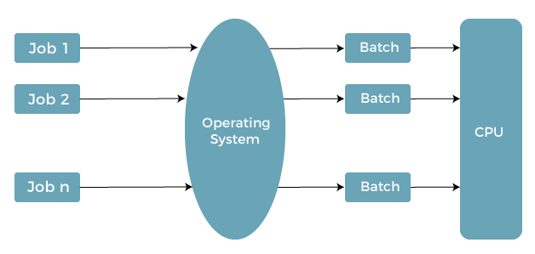
Batch Operating System

Slide 10
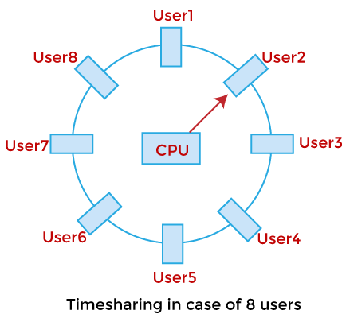
Time-sharing Operating System

Slide 11
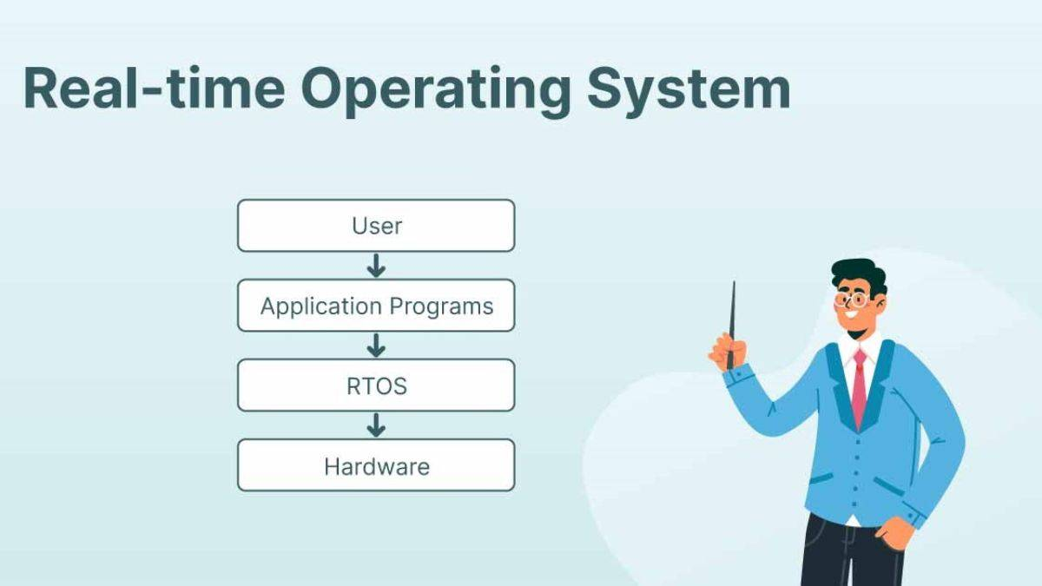

Slide 12
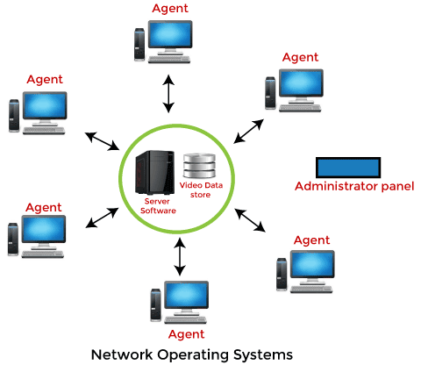
Network Operating System

Slide 13
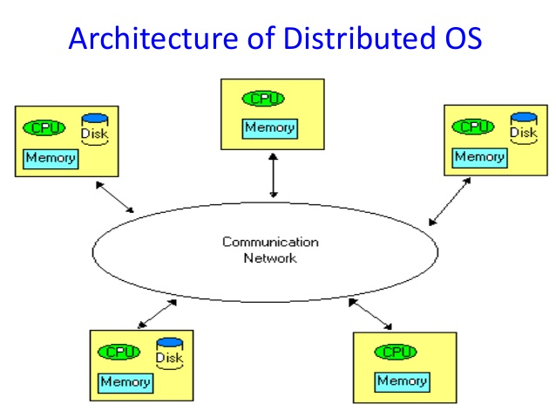

Slide 14
Distributed Operating System
It manages resources in a distributed systems
- seamlessly and transparent to the user
Looks to the user like a centralized OS
Example: Solaris, Mach-OS, AIX

Slide 15
Operating-System Operations
Interrupt driven
-Hardware interrupt
-Software interrupt (exception or trap):
    Software error
    Request for operating system service
    Other process problems include processes modifying each other.

Slide 16
Operating System Operations
Dual mode
Multimode

Slide 17

Transition from User to Kernel Mode

Slide 18
System Calls
Programming interface to the services provided by the OS
Typically written in a high-level language (C or C++)
Mostly accessed by programs via a high-level Application Programming Interface (API) rather than direct system call use

Slide 19

Example of System Calls

Slide 20

API – System Call – OS Relationship

Slide 21
Types of System call

Slide 22
Process control
  create process, terminate process
  end, abort
  load, execute
  get process attributes, set process attributes
  wait for time
  wait event, signal event
  allocate and free memory
  Dump memory if error
  Debugger for determining bugs, single-step execution
  Locks for managing access to shared data between processes

Slide 23
File management
  create file, delete file
  open, close file
  read, write, reposition
  get and set file attributes
Device management
  request device, release device
  read, write, reposition
  get device attributes, set device attributes
  logically attach or detach devices

Slide 24
Information maintenance
  get time or date, set time or date
  get system data, set system data
  get and set process, file, or device attributes
Communications
  create, delete communication connection
  send, receive messages(In case of message passing models)
  transfer status information
  attach and detach remote devices

Slide 25
  Protection
  Control access to resources
  Get and set permissions
  Allow and deny user access

Slide 26

Examples of Windows and Unix System Calls

Slide 27
Thank You

